Slide 1
Digital Marketing Essentials
Part 3: Market Research

Slide 2
Learning Objectives
At the end of this session, you will be able to
Understand why online market research is crucial to any marketing endeavor
Understand the most important concepts you need to know in order to start conducting research
User several methods for conducting online research, including surveys, online focus groups and online monitoring
Discuss what problems and pitfalls to avoid when researching online

Slide 3

The Importance of Market Research
Why do we conduct market research?
To understand current trends
To understand customer needs
To get to know popular opinions
To understand our competitors
Market research involves systematically gathering, recording and analyzing data about customers, competitors and the market, and turning this data into insight that can drive marketing strategies and campaigns.

Slide 4

Online Market Research
The process of using digital tools, data and connections to obtain valuable insights about a brand’s target audience (learning about your audience by engaging and observing them online)

Slide 5
Key concepts in market research
Four Key Concepts
Research methodology
Qualitative and quantitative data
Primary and secondary research
Sampling

Slide 6
Research methodology
A research methodology is the process you should follow in order to conduct accurate and valuable research.
Research should involve certain steps:
Establish the goals of the project (define your research question)
Determine your sample
Choose a data collection method
Collect data
Analyze the results
Formulate conclusions and actionable insights (for example, producing reports)

Slide 7
Primary and Secondary Research
Primary research based on primary data
Secondary research based on secondary data
 | Primary Research | Secondary Research
Data | New data is gathered for particular product or hypothesis. (information does not exist already or is not accessible) | Uses existing, published data as a source of information. (may not be sufficient to solve the problem at hand, since data are gathered for general purpose)
Cost | High | Comparatively low
Data collection | Survey, focus groups, research panels, research communities | Sales reports, web analytics, Facebook insights, customers communication records, search results (from search engines)

Slide 8
Primary and Secondary Research
The Internet and secondary research
Research based on secondary data should precede primary data research. It should be used in establishing the context and parameters for primary research:
The data can provide enough information to solve the problem at hand, thereby negating the need for further research.
Secondary data can provide sources for hypotheses that can be explored through primary research.
Sifting through secondary data is a necessary precursor for primary research, as it can provide information relevant to sample sizes and audience, for example.
The data can be used as a reference base to measure the accuracy of primary research.

Slide 9
Primary and Secondary Research
The Internet and primary research
Primary research involves gathering data for a specific research task.
Primary research can be either qualitative or quantitative.
Primary research can be used to explore a market and can help to develop the hypotheses or research questions that must be answered by further research.
Generally, qualitative data is gathered at this stage. For example, online research communities can be used to identify consumer needs that are not being met and to brainstorm possible solutions.
Further quantitative research can investigate what proportion of consumers share these problems and which potential solutions best meet those needs.

Slide 10
Activity 2
During the management meeting of ProTrainHub, an online training provider, the director wants to know what kind of training courses college students want to attend during their summer holidays. One of the manager suggested that they should conduct market research using survey questionnaires.
Question: Is it primary or secondary survey?
The marketing manager pointed out that they can look into trend data of registrations on their website and filter out by age, so that they will get some idea about what the college students want to study.
Question: Is it primary or secondary survey? And will it answer the director’s question?

Slide 11
Quantitative and qualitative data
 | Quantitative | Qualitative
Data gathered | Numbers, figures, statistics, objective data | Opinions, feelings, motivations, subjective data
Question answered | What? | Why?
Group size (Sample size) | Large | Small
Data source | Surveys, web analytics data | Focus groups, social media
Purpose | Tests known issue or hypotheses. Seeks consensus, the norm Generalizes data | Generate ideas and concepts – lead to issues or hypotheses to be tested. Seeks complexity Puts data in context
Advantages | Statistically reliable results to determine if one option is better than the alternatives. | Looks at the context of issues and aims to understand perspectives.
Challenges | Issues can be measured only if they are known prior to starting. Sample size must be sufficient for predicting the population | Shouldn’t be used to evaluate pre-existing ideas. Results are not predictors of the population.

Slide 12
Quantitative and qualitative data
Both quantitative and qualitative research can be conducted online.
Web analytics packages are a prime source of data.
Using data such as search terms, referral URLs and internal search data can lead to qualitative information about the consumers visiting a website.
However, when data is measurable and specific, such as impressions and click through rates, it leads to quantitative research.

Slide 13
Sampling
Qualitative research is usually conducted with a small number of respondents in order to explore and generate ideas and concepts.
Quantitative research is conducted with far larger numbers, enough to be able to predict how the total population would respond.
There are several sample size calculators available on the web.

Slide 14
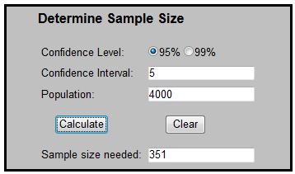
Sampling
For example, if you have 4 000 registered users of your website; you don’t need to survey all of them in order to understand how the entire population behaves. You need to survey only 351 users to get a sample size that gives you a 95% confidence level with a ±5% confidence interval. This means that you can be 95% sure your results are accurate within ±5%.
http://www.surveysystem.com/sscalc.htm

Slide 15
Online research methodologies
Which methodology should you choose?
That all depends on a variety of factors, from your research question and purpose to your budget and time.
Surveys: Ideal for collecting large amounts of quantitative data (and some qualitative data, too) – they are quick and easy to set up, and can run automatically.
Online focus groups: Ideal for engaging consumers and collecting qualitative data such as opinions, ideas and feelings about the brand – they require a larger time investment and a willing group of participants.
Online monitoring: Ideal for collecting qualitative data on brand sentiment, and can also provide some quantitative data around volume of interest in the brand – these data can be collected passively, and there are several tools that can automate this.

Slide 16


Activity 3

Slide 17
Activity 3
Arrange the following words into two groups:
“opinions, intentions, customer satisfaction (weighted average), attitudes, the most profitable customer age group, beliefs, number of downloads, referral URL”
Quantitative data | Qualitative data
Group size (Sampling) | Group size (Sampling)
Large Small | Large Small
Suggest data gathering methods to get quantitative data | Suggest data gathering methods to get qualitative data

Slide 18
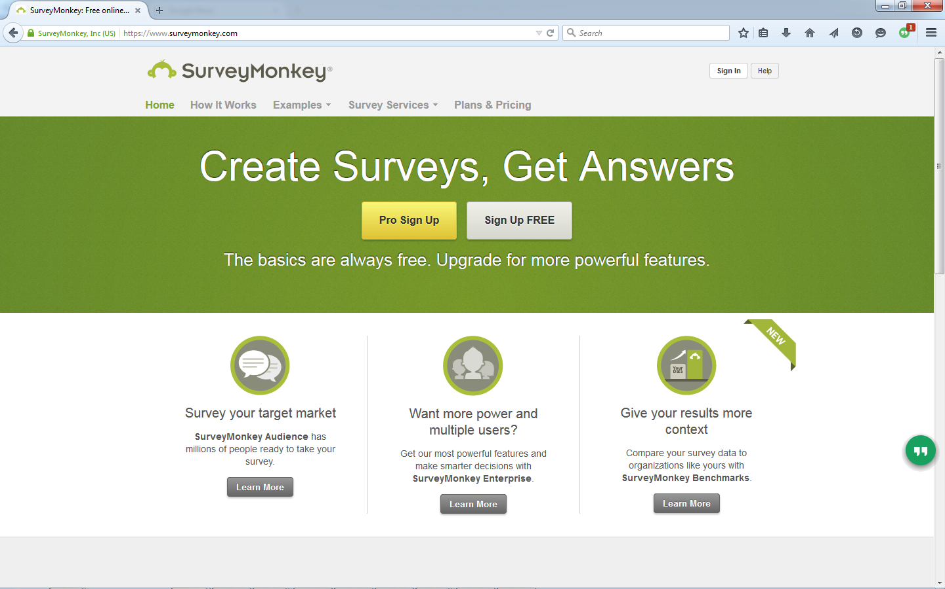
Surveys
Surveys are questionnaires that contains a series of questions around a specific topic.
Their purpose is to gather large volumes of quantitative data easily, though they can also collect some qualitative data.
https://www.surveymonkey.com/

Slide 19
Designing Surveys
Avoid leading questions
Phrasing questions in past tense will give you more accurate answers
Example:
Incorrect: We have recently introduced new features on the website to become a first class web destination. What are your thoughts on the new site?
Replace with: What are your thoughts on the changes to the website?
Example:
Incorrect: How many times a week do you buy take-away food?
Replace with: In the past month, how many times did you buy take-away food?

Slide 20
Designing Surveys
Open-ended Questions
To gather qualitative data, use open-ended questions
Example:
What features would you like to see on the website for Time magazine (www.time.com)?

Slide 21
Designing Surveys
Closed Questions
These questions give respondents specific responses from which to choose. These are typically multiple-choice questions with either one or multiple possible answers. This results in quantitative data.
Example:
Do you use the Time magazine website?
Yes
No
What features of the Time magazine website do you use? Tick all that apply.
Blog
World news
Free downloads
Additional resources

Slide 22
Designing Surveys
Ranked or ordinal
These questions ask respondents to rank items in order of preference or relevance. Respondents are given a numeric scale to indicate order.
This results in quantitative data.
Example:
Rate the features of the Time magazine website, where 1 is the most useful and 4 is the least useful. 4 3 2 1
Blog [ ] [ ] [ ] [ ]
World news [ ] [ ] [ ] [ ]
Free downloads [ ] [ ] [ ] [ ]
Additional resources [ ] [ ] [ ] [ ]

Slide 23
Designing Surveys
Matrix and rating
These types of questions can be used to quantify qualitative data.
Respondents are asked to rank behavior or attitude.
Example:
Rate the features of the Time magazine website according to the following scale:
1 = love it, 2 = like it, 3 = no opinion, 4 = dislike it.
4 3 2 1
Blog [ ] [ ] [ ] [ ]
World news [ ] [ ] [ ] [ ]
Free downloads [ ] [ ] [ ] [ ]
Additional resources [ ] [ ] [ ] [ ]

Slide 24
Activity 4

Slide 25
Activity 4
Café J is a popular coffee shop in town. It has introduced a new product “Yogurt Coffee” last a few months ago, and the management wants to know how customers think about its new product in terms of taste, serving size, and price. They want to conduct the survey to all customers ordering Yogurt Coffee in the store for 3 months, offering FREE cookie to the respondent.
Suggest some questions for above market survey.

Slide 26
Focus Groups
Online focus groups involve respondents gathering online and reacting to a particular topic.
Respondents can be sourced from all over the world and react in real time, arguably being freer with their responses since they can be anonymous in an electronic environment.
Online focus groups are ideal for having frank, detailed conversations with people who have an interest in your brand – this means they result in primary, qualitative data. This information can then be used to create quantitative research questions.
Range of technologies available – Text Messaging to Video Conferences

Slide 27

Focus Groups
Good options for conducting online focus groups include:
Google Hangouts: https://hangouts.google.com/
Skype: www.skype.com/en
GoToMeeting: www.gotomeeting.com/

Slide 28
Focus Groups
Less formal then surveys (researcher may not have full control over conversation)
Focus groups are used to get consumer views on:
New products or marketing campaigns
Existing products and campaigns, and how they can be improved
Sentiment around the brand
Views on a brand’s new direction or visual style
Ideas for how the brand could improve its position or branding.
Good for collecting qualitative data quickly
Should choose enough participants – 8 to 10 is good range

Slide 29
Activity 5

Slide 30
Activity 5
Do you think the Café J in Activity 4 should use focus group instead of survey? What will be the pros and cons of focus group in this situation?

Slide 31
Online Monitoring
Difficult in offline world, but easy to monitor online
Keywords – the foundation to categorizing and indexing the web – make it simple to track conversations taking place online
Online tools allow a company to track mentions of itself, its staff, its products, its industry and its competitors
You may search for
Broad match (apple computers)
Direct match (“Apple computers”)
Inclusive match (Apple +computers)
Exclusive match (Apple –fruit)

Slide 32
Tools for monitoring
Google Alerts
Google news
Google blog search
Google patent search
Google video search
Technorati
Flickr
Delicious

Slide 33
Other avenue for online research
Personal interview
Observation/Online ethnography
Online research communities
Listening labs
Conversion optimization (A/B testing)

Slide 34
Tools of the trades
Survey tools
SurveyMonkey: www.surveymonkey.com
Wufoo: www.wufoo.com
Kwik Surveys: kwiksurveys.com
Google Forms: accessed through Google Drive drive.google.com
Qualaroo Insights (unique real-time offering): qualaroo.com

